Slide 1
GeoPose Automated Compliance Testing …Getting Started [updated March 2022 with some answers from the meeting]
The 121st OGC Member Meeting
Steve Smyth, GeoPose SWG Editor
7 December 2021

Slide 2
GeoPose Conformance Testing
Overview
Scope
Standardization targets
Ten targets
Independent except for Stream Header and Stream Element
Conformance testing
During development – we used a simple API to generate samples and to validate JSON-encoded data objects
Transition to OGC CITE
Some observations and questions

Slide 3
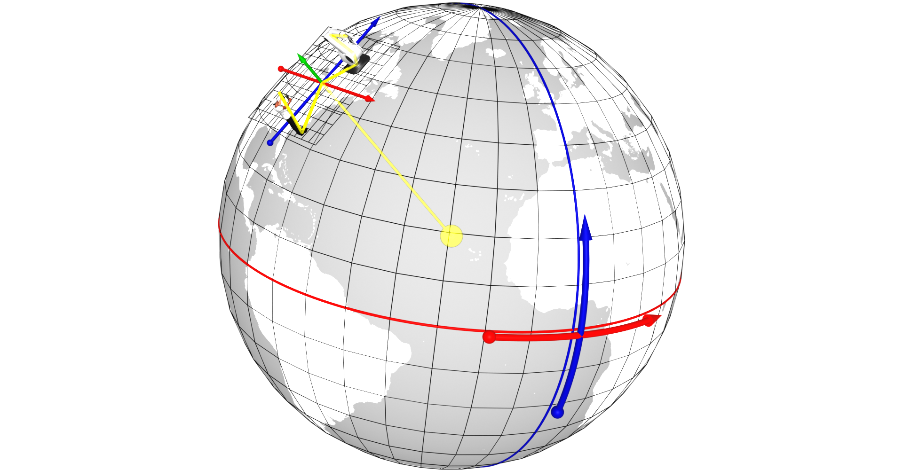
GeoPose
A Pose captures position and orientation of a real or digital object.
A Pose has an associated FrameTransform Chain. The Pose’s FrameTransform Chain encapsulates sufficient information to transform pose geometry in any component Reference Frame to any other Frame in its associated FrameTransform Chain.
A Fixed Pose is a Pose whose associated Outermost Frame is related to an Ephemeris Object - a spatial object whose position and orientation are externally defined.
A GeoPose is a Fixed Pose related to a geospatial Ephemeris Object (the Earth) via a Topocentric Reference Frame.
Short Version:
A GeoPose ties the position and orientation of a spatial object to the Earth’s surface.
Notes:
From this we derive the idea of poses, and the chained reference systems to relate between the geographical, Earth-based system and individual objects and their histories of locations and orientations

Slide 4
Structure
Normative part:
Specification document with conformance classes directly referencing UML logical model.
UML logical model as Enterprise Architect 14 project file .
A single encoding for GeoPose 1.0: JSON – derived automatically from UML
Json object validator uses same automatically generated JSON-Schema files that are included into the draft’s AsciiDoc files.
An example generator API using a “SolarPose” back end.
Informative part:
Reviewers Guide – Informative explanation of the GeoPose draft standard and its development
Users Guide – Developer-focused implementation guide
Test datasets
SolarPose, Dalek, and Land drone example applications

Slide 5
Details
Much of the normative part of the document is created automatically from the UML model. This includes a linked set of JSON-Schema specifications, JSON-encoded example GeoPoses, and an online GeoPose validator for each of the eight standardization targets.
The SWG has actively reached out to OGC and external related standards groups in order to better understand
How GeoPose might be used
Additional use cases
Possible additional requirements
We have received considerable sample data, some of which has been converted to conform to our draft spec. We have a plan to complete an application based on a “land drone” data set from Ordnance Survey GB in October 2021. This application will use every one of the eight independent standardization targets.
The SWG unanimously approved the draft spec with OGC document number 21-056 for OAB review and public comment on 17 September 2021.

Slide 6
GeoPose Scope
Individual concrete data objects for the exchange of anchored poses, each interpretable as a linked position and orientation tied to an externally-defined frame of reference, for example an Earth-centered, Earth-fixed geodetic spatial reference system. The linkage may be direct or through a chain of frame transformations.
Composite structures
Sequences grouping anchored poses in time series and delivered as a packaged sequence or unbounded stream.
Linked structures representing networks of reference frames, expressed as a graph where the nodes are frames and the edges are transformations between the linked frames. Chains are intentionally distinguished as a special type of graph because they are a common special case with a simpler representation.
Out:
API
Transports
Uncertainty: accuracy, precision
Other kinematic or dynamical properties: velocity, acceleration, angular velocity
Camera model
Metadata
Security

Slide 7
Standardization Targets
The Basic-YPR and Basic-Quaternion targets are simple and concise – no options. They satisfy most use case requirements and assume a local tangent plane east north up (LTP-ENU) frame derived from WGS84 (EPSG 4979).
An Advanced GeoPose target supports more complex use cases where the outer geographic reference frame is not LTP-ENU and/or a valid time is needed.
Composite:
The Chain GeoPose target provides additional flexibility with multiple intermediate frames or specific coordinate reference systems as needed.
The Frame Graph target supports the full structure need to represent networks of reference frames that arise with the use of multiple and linked location technologies.
The three (Time) Sequence targets support the packaging of fixed-length time series of GeoPoses and the payload data objects for open-ended GeoPose streams.
The standardization targets are independent. A minimum conforming implementation need only conform to the requirements of a single encoding of a single target.

Slide 8
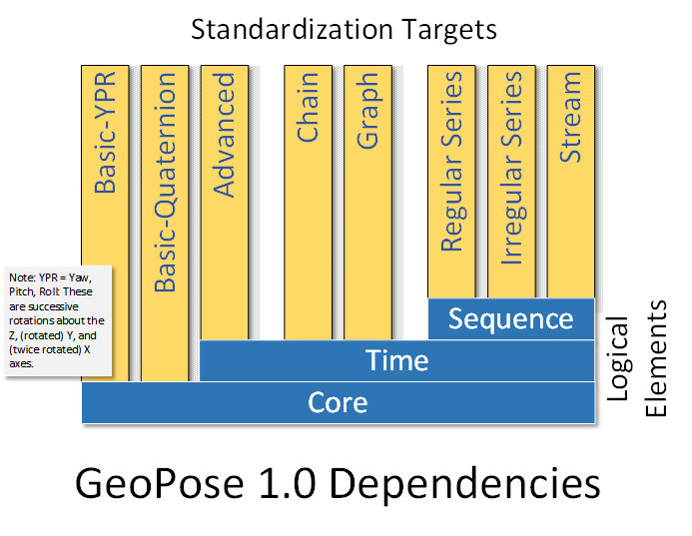
Standardization Target Dependencies

Slide 9
Automated Compliance Testing
Validate JSON objects against JSON-Schema
This is simple.
SWG has done this with an API using Swagger/OpenAPI documentation for the past year.
Have begun work to implement tests in the OGC framework.
Questions
Is it JSON-Schema validation too simple to be useful? [Answer: No.]
Should our test only address web services like this? What about files or collections of files? [Answer: files don’t really fit the certification model.]
Are we using the best hosting for our ten JSON-Schema 2019-09 files? [Answer: OK if it is persistent.]
https://github.com/opengeospatial/GeoPose/blob/main/standard/standard/schemata/GeoPose.Basic.YPR.Schema.json
https://github.com/opengeospatial/GeoPose/blob/main/standard/standard/schemata/GeoPose.Basic.Quaternion.Schema.json
https://github.com/opengeospatial/GeoPose/blob/main/standard/standard/schemata/GeoPose.Basic.Strict_Quaternion.Schema.json
https://github.com/opengeospatial/GeoPose/blob/main/standard/standard/schemata/GeoPose.Advanced.Schema.json
https://github.com/opengeospatial/GeoPose/blob/main/standard/standard/schemata/GeoPose.Composite.Chain.Schema.json
https://github.com/opengeospatial/GeoPose/blob/main/standard/standard/schemata/GeoPose.Composite.Graph.Schema.json
https://github.com/opengeospatial/GeoPose/blob/main/standard/standard/schemata/GeoPose.Composite.Sequence.Series.Irregular.Schema.json
https://github.com/opengeospatial/GeoPose/blob/main/standard/standard/schemata/GeoPose.Composite.Sequence.Series.Regular.Schema.json
https://github.com/opengeospatial/GeoPose/blob/main/standard/standard/schemata/GeoPose.Composite.Sequence.Stream.Header.Schema.json
https://github.com/opengeospatial/GeoPose/blob/main/standard/standard/schemata/GeoPose.Composite.Sequence.StreamElement.Schema.json
Should we target an API used for test only? [Answer: Yes, a conforming implementation must use the API to deliver data objects.]
How does OGC describe compliance on a per-standardization target basis?. [Answer: Per target.]

Slide 10
Conclusions
Keep our automated testing via OpenAPI/Swagger on GeoPose web site. Primarily for developer support.
Define an API as a test harness for services that deliver or consume one or more standardization targets. Primarily for OGC compliance certification.
Use SolarPose as an example for developers
Wire up OGC CITE to work with the API

Slide 11
GeoPose SWG
geopose.swg@lists.opengeospatial.org
Contact info@ogc.org to schedule a meeting for an in-depth discussion with OGC staff and join our community today!
Notes:
If you have any questions, do not hesitate to reach out to OGC or schedule a follow-up. We’re working constantly to change the landscape of location information and want to help your organization get where it needs to go.

